Slide 1
CEIS110 Module 4
Querying the database with SQL

Slide 2
Rubric
Activity | Requirement(s) | Points
Query to retrieve all columns and rows | Screenshot of query and results | 20
Query to retrieve lowest and highest temperature | Screenshot of query and results | 20
Query to find all Clear days | Screenshot of query and results | 20

Slide 3
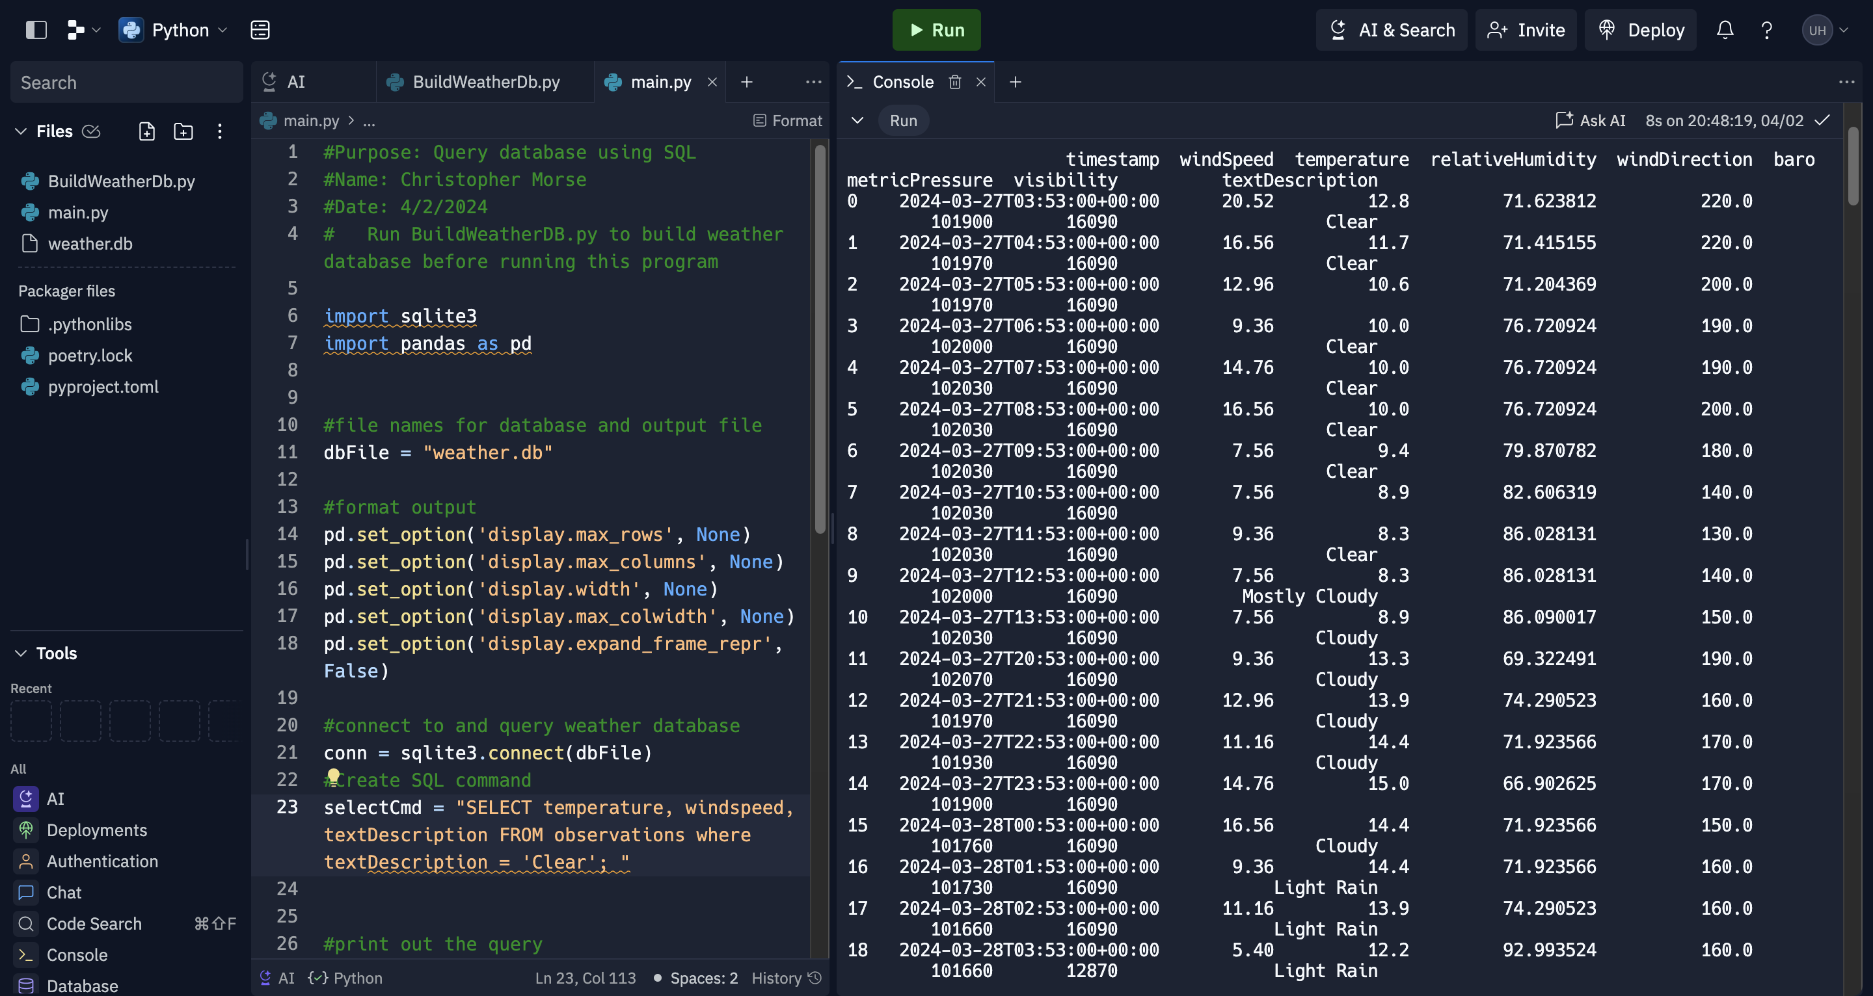
Query to retrieve all columns and all rows (Screenshot)
Screenshot of SQL query command and results

Slide 4
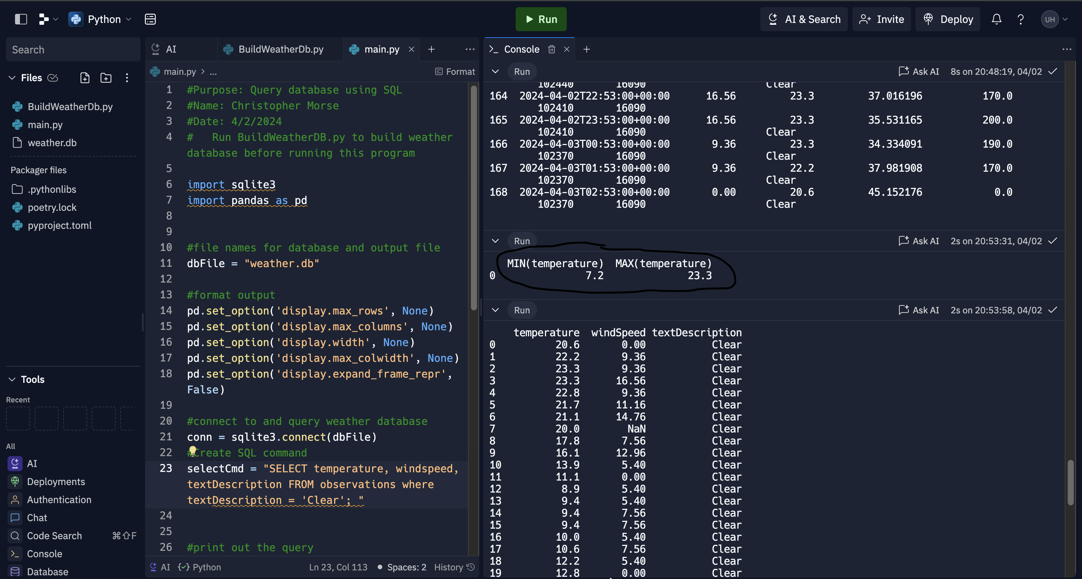
Query to retrieve lowest and highest temperatures (Screenshot)
Screenshot of SQL query command and results

Slide 5
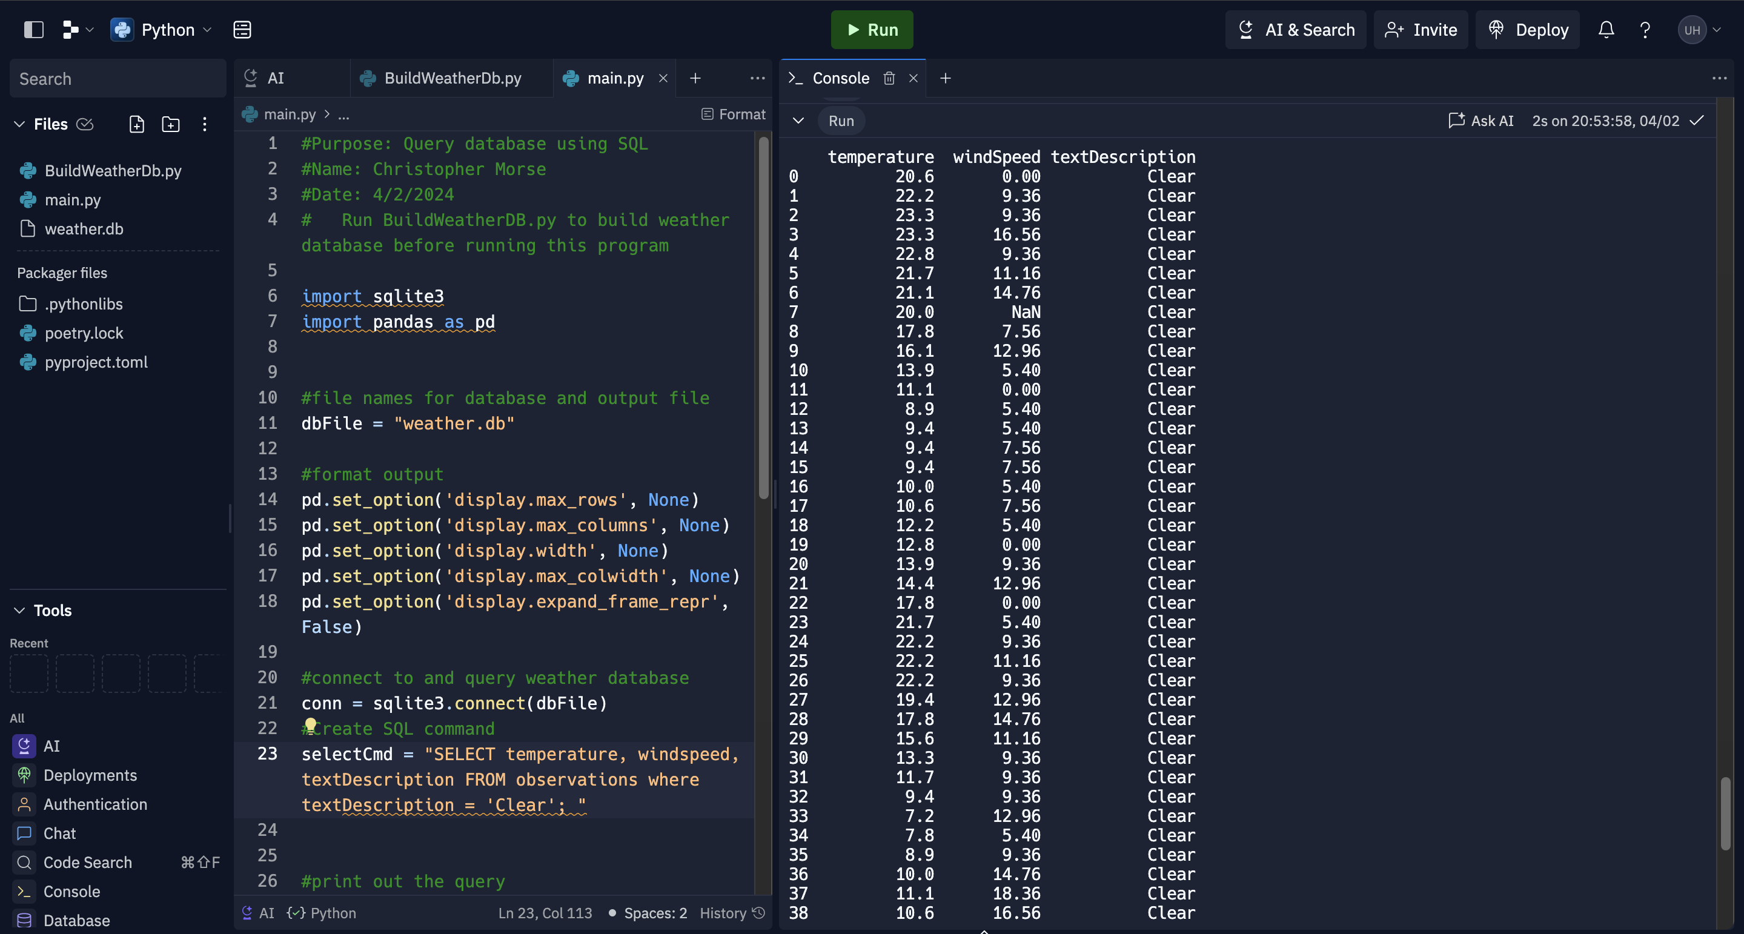
Query to retrieve all clear days (Screenshot)
Screenshot of SQL query command and results

